Slide 1

LEAN STARTUP MANAGEMENT
COURSE CODE: MGT1022
FACULTY NAME: PROF. Venkatesh Rajagopalan

Slide 2
WOMEN SECURITY
BY:
19BAI1073 RITHEESHA PRIYA KOVUR 19BCE1083 N A PRASANNA VENKATESH
19BCE1263 RIYA RANI 19BCE1290 SABRINA MARSHAL
19BCE1327 KARTIKEY GAUTAM 19BCE1459 MEGHNA MANOJ NAIR
19BCE1564 S V S AKHIL RAMAN 19BCE1644 CHARU ANANT RAJPUT
19BCE1698 SAM METHUSELAH 19BCE1759 SABARI GIRISH S
19MIS1013 YAGANTI MOUNIKA SAI 19MIS1047 GENKUNTLA PRANITHA

Slide 3
Review 1I

Slide 4
OBJECTIVE OF THE STUDY
It is unsafe for women out there even though the law has become stricter in dealing with such felonies. What we, as a team, our trying to do is to make a product which will help the authorities ascertain the location of the victim and maybe stop the crime from happening or from getting worse. The motive is to let the people know how bad the security of women in the country is and to possibly help better this situation with our product.
In incidents like these, it is really hard for the victim to alert others through their smartphones especially in isolated areas. Also in these scenarios it becomes difficult to take out and access your phone. In these types of situations, our device will be really useful. It is small in size, easy to carry and alerts the enlisted emergency contacts on the click of a button. Therefore, all the emergency contacts get an SMS of your location and thus it’s easy to reach the location on time.

Slide 5
LITERATURE REVIEW
India ranks amongst the top 10 un-safest countries for women in the world. Everyday, there are hoards of news about rape cases, dowry cases, girl trafficking and many more. In our country, a rape takes place every 2 minutes, and this is in a society wherein such cases are widely oppressed, hence the situation might even be worse than we or the government knows.
The sheer barbarity involved in the crime committed against the 23-year-old paramedic student, who later came to be identified as “Nirbhaya” (meaning fearless), jolted the collective conscience of India’s 1.3 billion people, uniting them in a call for the instant execution of the perpetrators. Thousands of women and activists stormed the streets to demand action in the name of the victim, breaking the usual silence over sexual violence, which often goes unreported.

Slide 6
Taken aback by the backlash, and to appease a nation convulsed by anger, the Indian government implemented legal reforms mandating harsher punishments for rapists. The prison sentence term for rapists was doubled to 20 years, stalking was made a crime, and new initiatives aimed at improving safety for women were launched. In 2014, shortly after Prime Minister Narendra Modi took office, his government also pledged a “zero tolerance” policy on violence against women, promising to “strengthen the criminal justice system.”
Yet oddly, seven years on and stiffer punishments for the guilty notwithstanding, a sense of disenchantment still lingers in the air. Women feel they aren’t any safer on the streets as, among other things, ossified patriarchal norms rob them of agency.

Slide 7
Facts
Almost 75% of crimes against women go unaccounted and never reported under a fear of societal impact.
Majority of these crimes are severe and repetitive.
Almost 48% of reported rape cases are against minors.
Every 2 minutes, a crime against a woman takes place in the country while a rape takes place in every 15 minutes.
Almost all cases have a close linkage between the suspects and the victims.
Just a small 3% of the cases reported in India turn out to be false acquisitions by the girl.
In certain states of the country, molestation of girls (especially underage girls) is so prominent that girls have started to believe that it is an extremely normal thing to do and hence don’t even try to report such cases.
India ranks 3rd in terms of underage pregnancy and the main reason for this is again rapes.

Slide 8
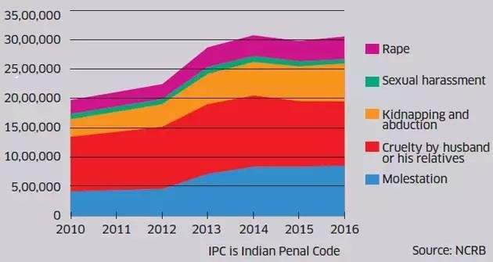
STATISTICIAL DATA THROUGH GRAPHS
Figure 1: As many as 2.24 Million cases have been reported in the past decade and almost twice the number of these cases are believed to have not been reported. This is an official image published by NCRB of India
As quite visible from the above graph, the toll of such crimes is on a rise and that too an alarming rate. From less than 20 lakh cases, it has increased to a whopping number of more than 30 lakh cases in a year by the end of 2016.

Slide 9
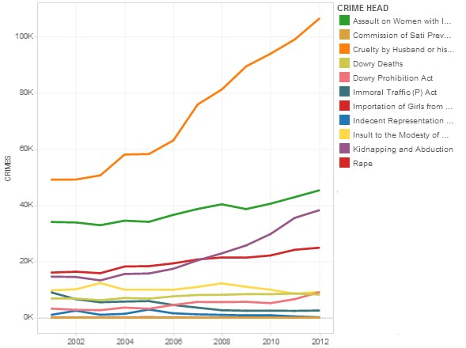
Figure 2: This official graph from our collected datasets showcases a similar trend from the year 2001 to 2012

Slide 10
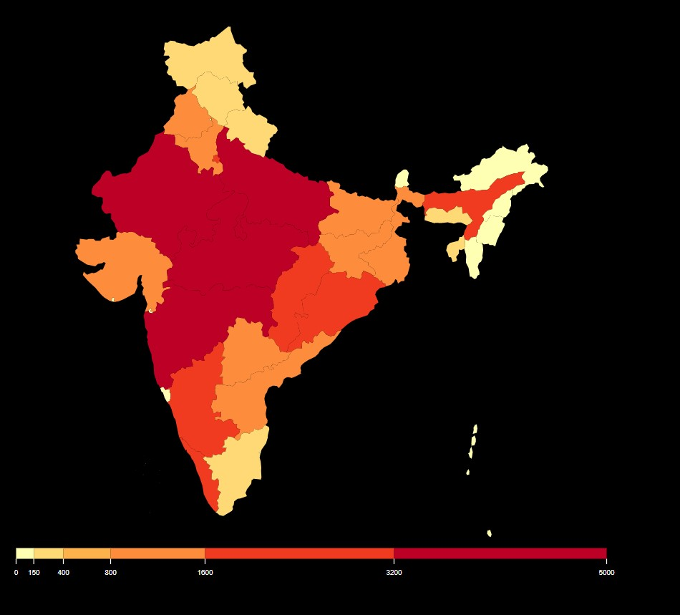
Figure 3: This colour map gives a view of every states' crime rates against women. The data is based on 2018 publication by NCRB. Note: This image shows all crimes against women
Statistically, a rape case is reported every minute in the country. And what’s even worse is that in most of these cases, the suspect is related to the victim.

Slide 11
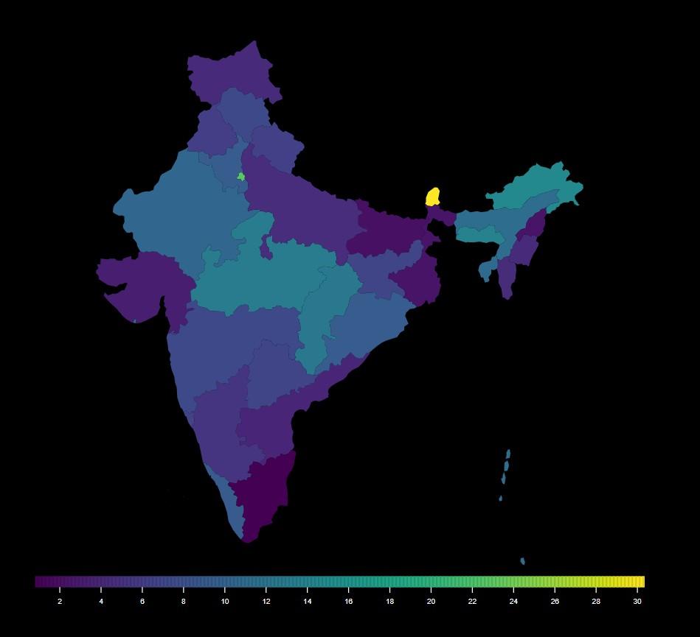
Figure 4: This colour map shows rapes in every state per lakh population

Slide 12
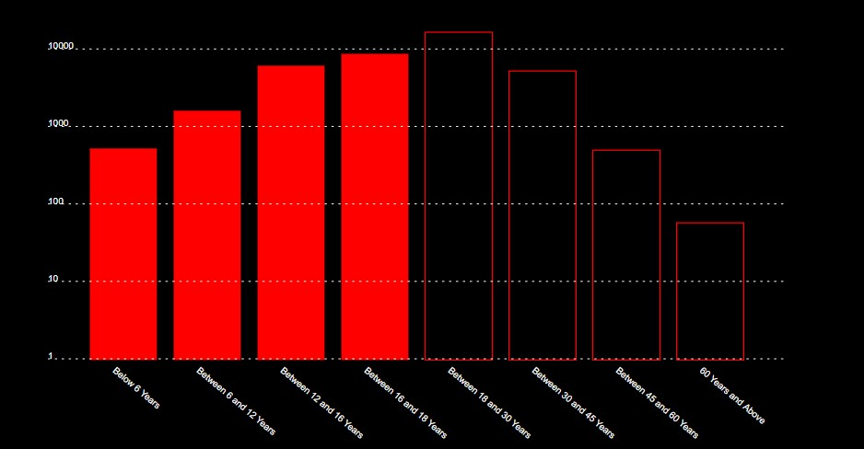
Some bar graphs showing the ages of the victims.
Figure 5: Half of the rape victims in the country are minors.

Slide 13
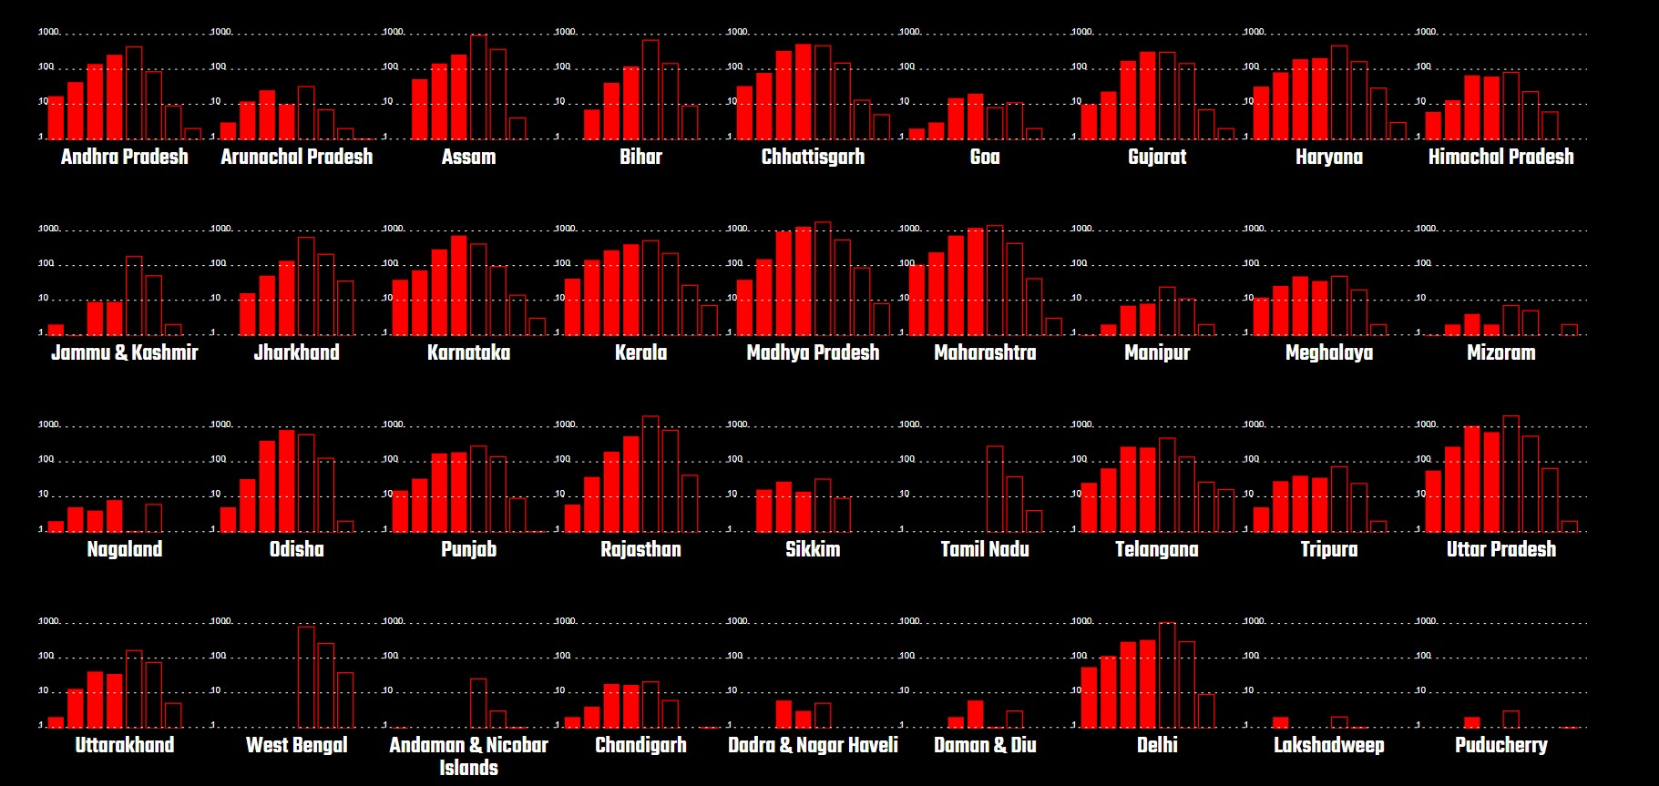
Figure 6: A detailed collection of histograms showing the state-wise distribution of age groups of victims

Slide 14
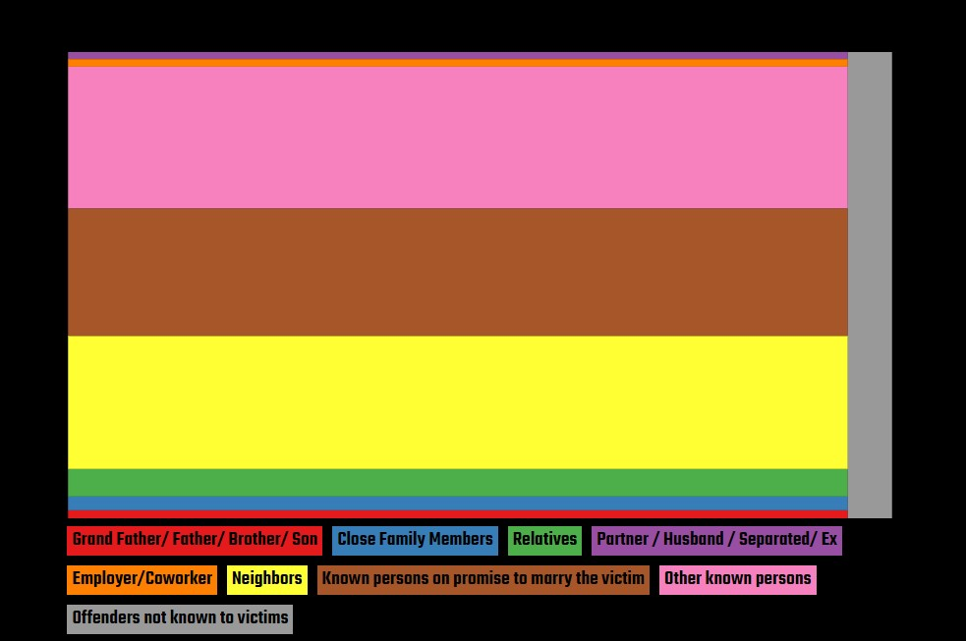
Tree maps show how many of the victims actually knew the suspects.
Figure 7: As can be seen almost 90% of the suspects are close relatives of the victims.

Slide 15
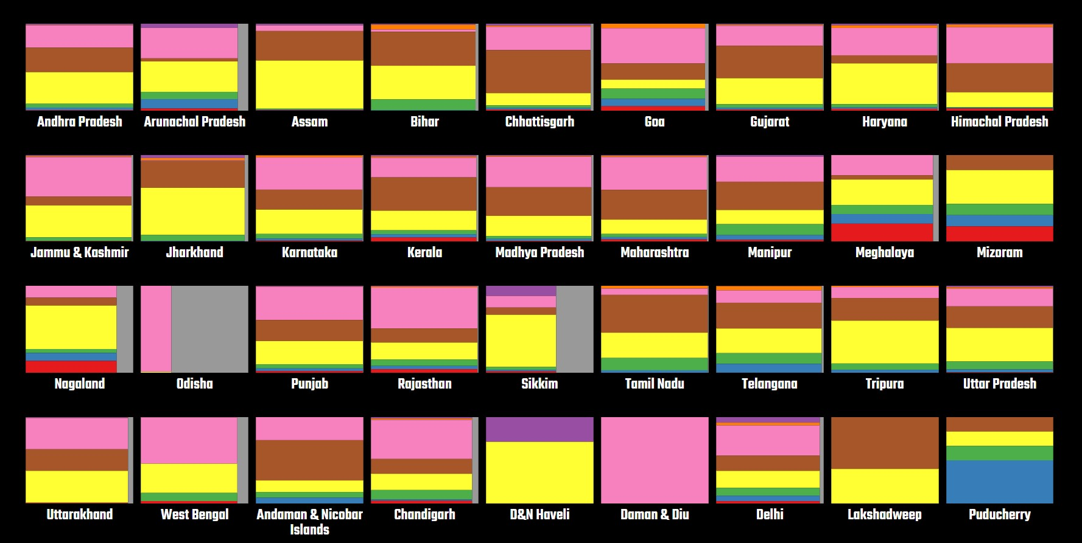
Figure 8: Tree maps showing various states' data for victims and their relations with the offenders

Slide 16
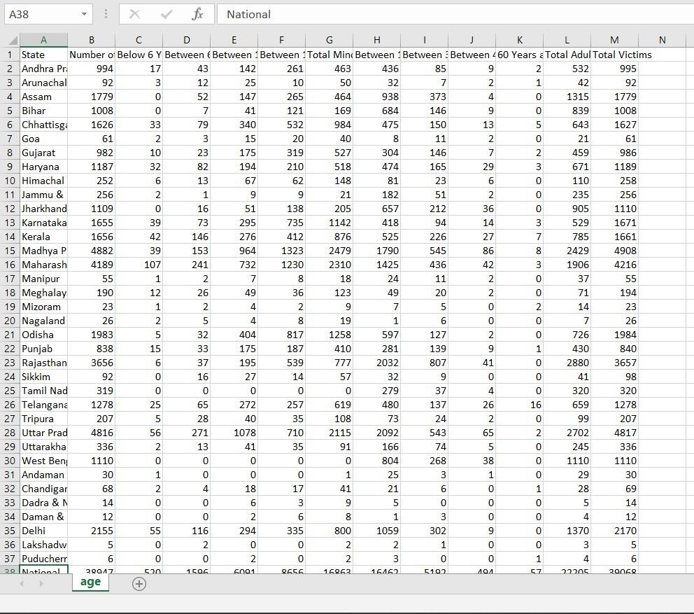
Figure 9: Dataset showing ages of the victims

Slide 17
STATEMENT OF PROBLEM
Through the entire visual approach, the members of this project have just tried to show how unsafe it is for women out there even though the law has become stricter in dealing with such felonies. What we, as a team, our trying to do is to make a product which will help the authorities ascertain the location of the victim and maybe stop the crime from happening or from getting worse.
The visual approach was and is meant for the masses to make them aware and to take necessary steps and precautions in keeping their loved ones safe.

Slide 18
Our product
What we will do is produce a device which will be small and thus easy to carry. It will have a button and what we are aiming at is, creating a device which will act as a distress signal to alert the authorities about the crime taking place.
The product will be cheaper and much more handy. It will send an SOS signal at the click of a button and therefore we don’t have to depend on our smartphones to do the same.

Slide 19
In situations like these, it becomes really difficult to access our smartphones assuming we have it in the first place. Not everyone can afford a smartphone and hence this further decreases our chances of alerting someone.
This is where our device will come in handy. The materials being used to create this device our cheap and thus it will be affordable.
When a user presses the button on our device, it will automatically send an SMS which will be including our location(latitude and longitude) to the listed emergency contacts. The emergency contacts are provided by the user.
Thus we will be able to alert the authorities before things could get worse.

Slide 20
Bibliography and References
National Database on Sexual Offenders
The National Crime Records Bureau
https://scroll.in/article/753496/crimes-against-women-reported-every-twominutes-in-india
Chapter 5: Crime against women", Crime in India Statistics
https://towardsdatascience.com/indian-crime-data-analysis-85d3afdc0ceb
https://ncrb.gov.in/sites/default/files/crime_in_india_table_additional_table_chapt er_reports/Table%203B.2_0.pdf
https://thediplomat.com/2020/01/addressing-rape-in-india/

Slide 21
Thank You

